Slide 1


Slide 2
Historical Employment Transformation in Schleswig-Holstein
1882 - 1939
Björn Hansen, Kiel (10.07.2025)

Slide 3
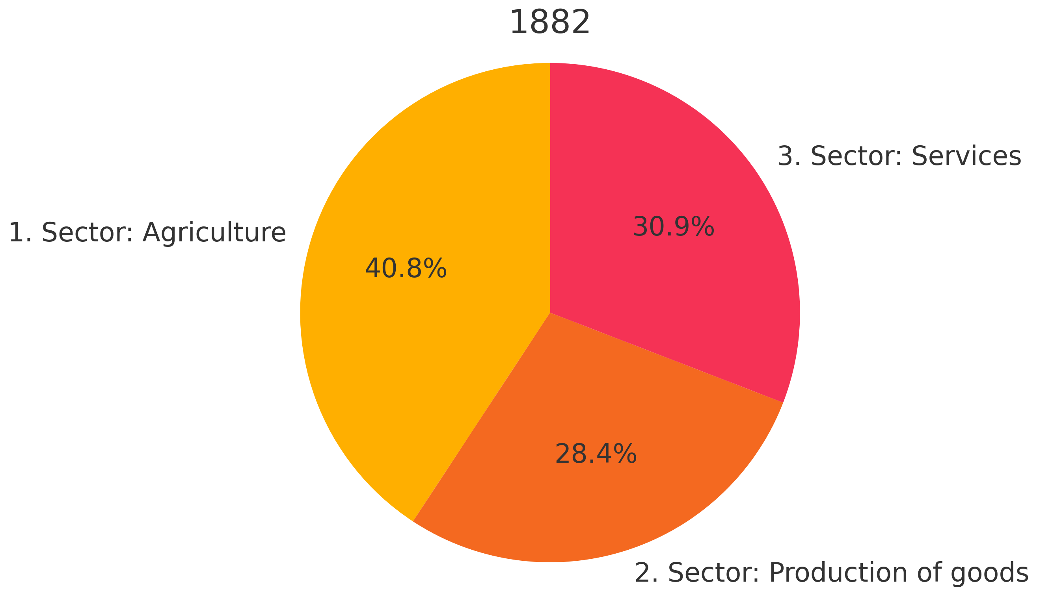
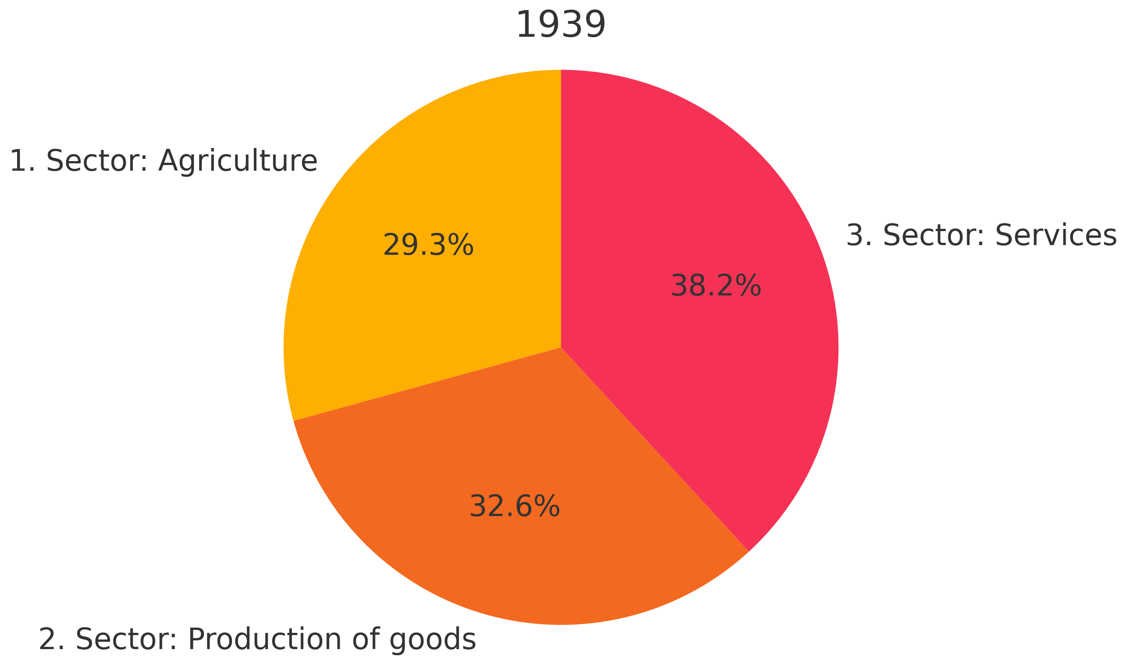


Introduction: Sectoral Employment Shifts in Schleswig-Holstein
Agriculture
Production
Services
Two possible transformation paths:
Young employees began their careers in expanding sectors, while older employees remained in declining sectors
Employees switched into modern sectors during their working lives

Slide 4
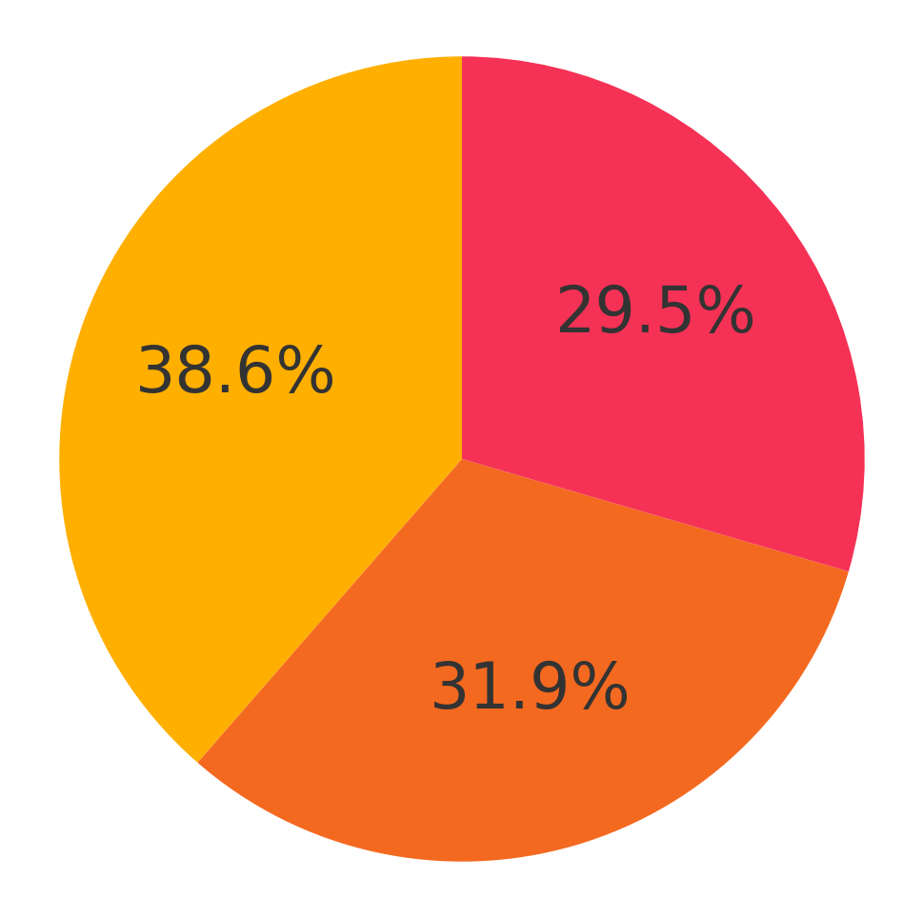
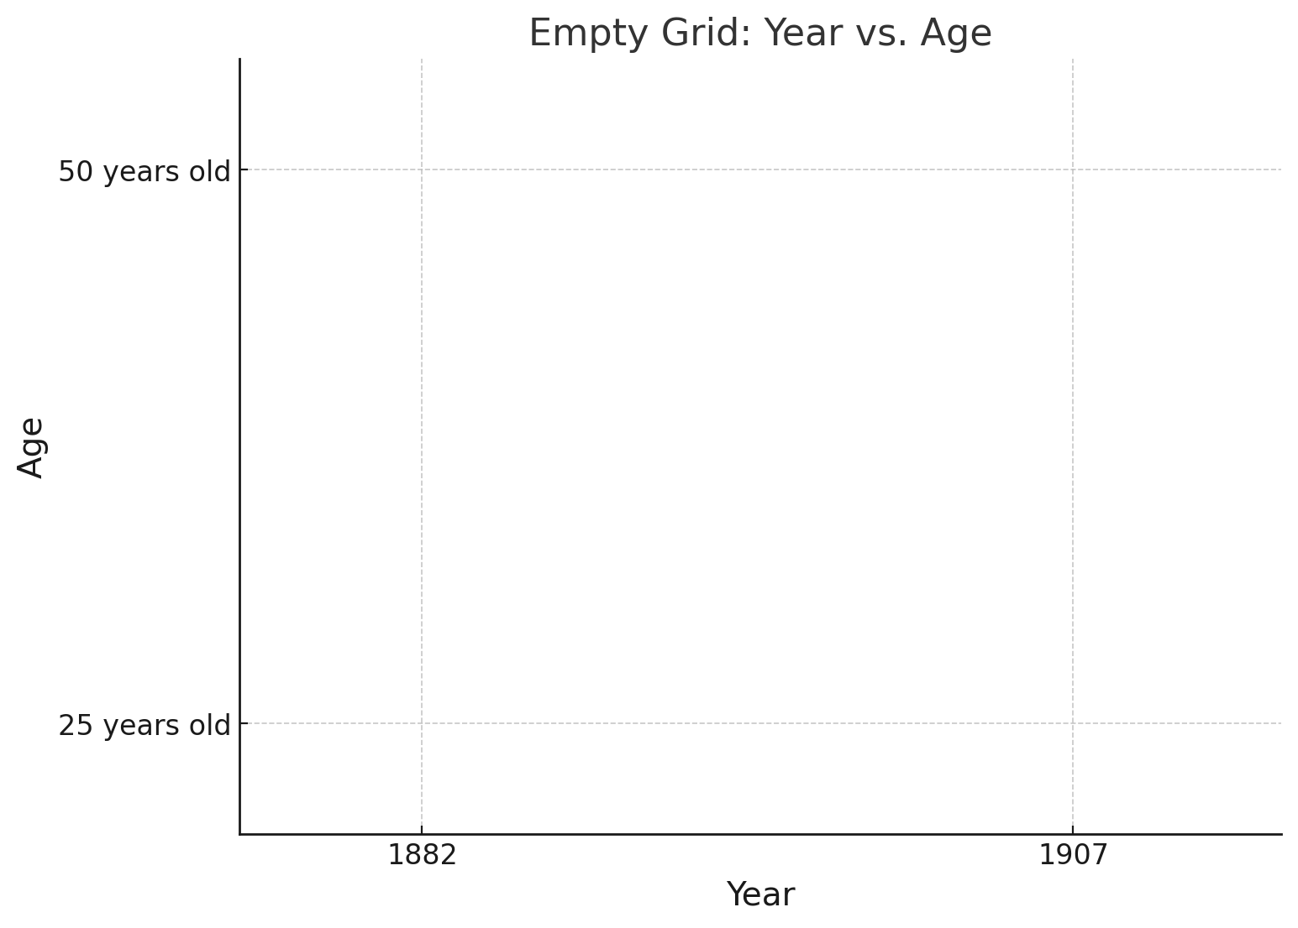
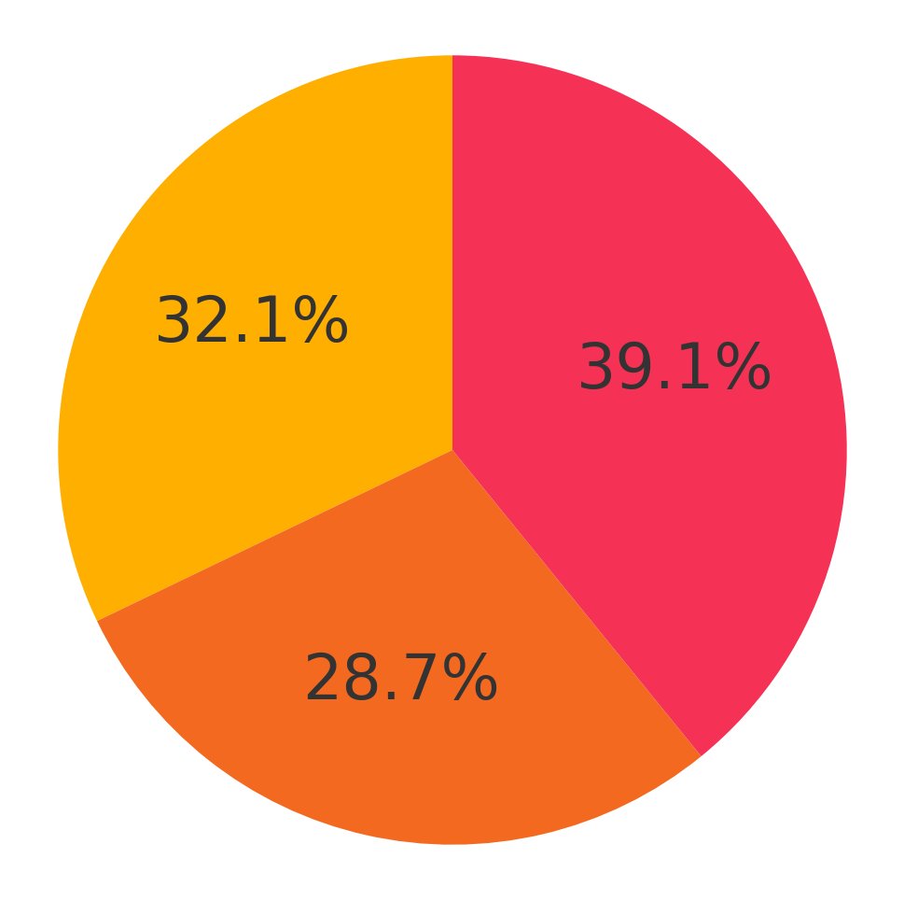

Young employees began their careers in expanding sectors, while older employees remained in declining sectors
?
Employees switched into modern sectors during their working lives
?
Data from a sample cohort – Employees born in the year 1857 (25 years old in 1882 and 50 years old in 1907):
Young employees began their careers in expanding sectors (production and services).
However, towards the end of their careers, they moved into the declining sector (agriculture).
This contradicts the general economic trend, making the transformation particularly complex – the trend is not my friend
How can this transformation be measured effectively?
Agriculture +6.5%
Production + 3.2%
Services -9.6%

Slide 5
Research question: How can the transformation be effectively measured?
During which periods, and for which cohorts, was the employment transformation in Schleswig-Holstein (SH) particularly pronounced? Conversely, when was this transformation relatively weak?
Due to the uniqueness of this historical event, establishing a benchmark is challenging.
I therefore propose using the employment trends from the German Empire (Deutsches Reich) as a comparative template for Schleswig-Holstein.
The method involves: Training a neural network on data from the German Empire. Applying this trained model to Schleswig-Holstein's data to identify deviations.
If the transformation observed in Schleswig-Holstein is greater than expected based on sectoral distribution and employee age, the transformation is considered particularly strong.
Conversely, weaker-than-expected transformations indicate relative weakness.
?

Slide 6
Dataset Characteristics
Official census data is available for the years 1882, 1895, 1907, 1925, 1933, 1939 – no additional annual data is available.
Employment data is categorized into three economic sectors (agriculture, production of goods, and services) and divided into age cohorts (ranging from under 15 to over 70) – no data for every single age For instance, the 1882 census data are available only for specific age cohorts:
under 15 15 to 19 20 to 29 30 to 39 40 to 49 50 to 59 60 to 69 70 and above

Slide 7
Data Preprocessing
Step 1: Imputation of the missing values for each census separately (example for 1882):
Available data (cohorts and sectoral distribution):
Available data was assigned to specific birth years, and missing values were indicated with NaN.
under 15: 55.7%, 27.2% 17.1%
15 to 19: 44.9%, 33.0% 22.1% 20 to 29: 35.8% 34.3% 29.8% 30 to 39: 38.6%, 40.1%, 21.3%
…
14: 55.7%, 27.2%, 17.1% 15: NaN 16: NaN 17: 44.9%, 33.0%, 22.1% 18: NaN 19: NaN 20: NaN 21: NaN 22: NaN 23: NaN 24: NaN
25: 35.8%, 34.3%, 29.8% 26: NaN 27: NaN 28: NaN 29: NaN 30: NaN 31: NaN 32: NaN 33: NaN 34: NaN 35: 38.6%, 40.1%, 21.3%
… … …
The year values were normalized within the observed birth-year range (1812–1868 → [0, 1]).
Sectoral distributions were not normalized further, as they already represent proportions between 0 and 1.
Missing values are masked (NaN)
A bidirectional LSTM layer was utilized to capture dependencies in both temporal directions.
NaN = not a Number

Slide 8
Data Preprocessing
# individual loss funktion
def masked_mse(y_true, y_pred):
mask = tf.cast(tf.math.not_equal(y_true, 0.0), tf.float32)
loss = tf.reduce_sum(tf.square(y_true - y_pred) * mask) / tf.reduce_sum(mask)
return loss
class TemperatureSoftmax(Layer):
def __init__(self, temperature=2.0, **kwargs):
super().__init__(**kwargs)
self.temperature = temperature
def call(self, logits):
return tf.nn.softmax(logits / self.temperature)
model = tf.keras.Sequential([
tf.keras.layers.Input(shape=(X_input.shape[1], X_input.shape[2])), # Input (timesteps, features) tf.keras.layers.Bidirectional(tf.keras.layers.LSTM(32, return_sequences=True)),
tf.keras.layers.Dense(3), # 3 output values for the three sectors
TemperatureSoftmax(temperature=2.0) # use of the individual softmax layer # softmax produces percentage values, sum = 1
])
model.compile(optimizer='adam', loss=masked_mse) # adam as optimizer, individual loss function (masked_mse)
The loss function calculates errors exclusively for available (non-missing) values.
The function minimizes the Mean Squared Error (MSE).
A TemperatureSoftmax function was implemented to control the smoothness of the probability distribution across sectors (effect of the transformation):
Temperature < 1: Sharper distribution Temperature = 1: Standard softmax Temperature > 1: Smoother, more uniform distribution

Slide 9
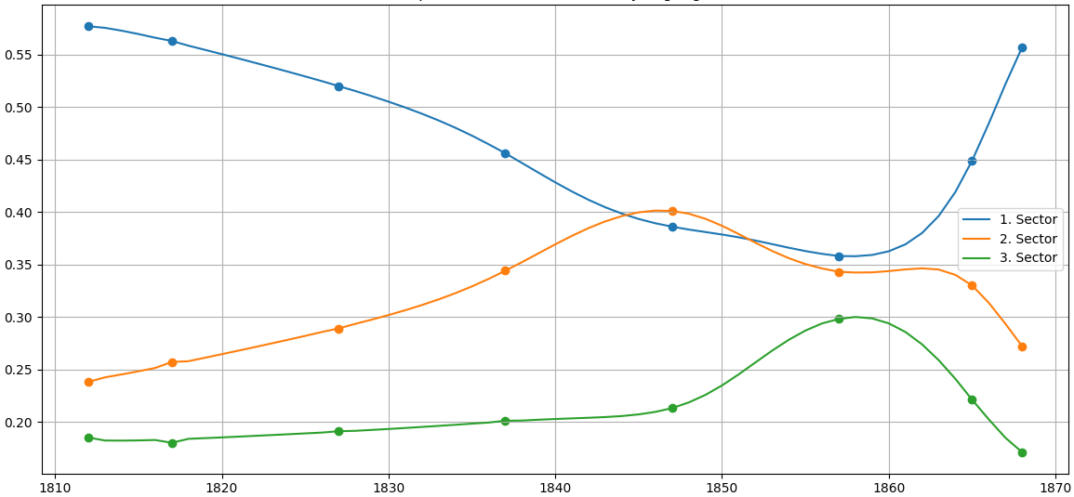
Data Preprocessing
Example for the census of 1882:
Age 14
Age 70
Age 65
Age 45
Age 17
Age 55
Age 35
Age 25

Slide 10
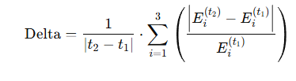
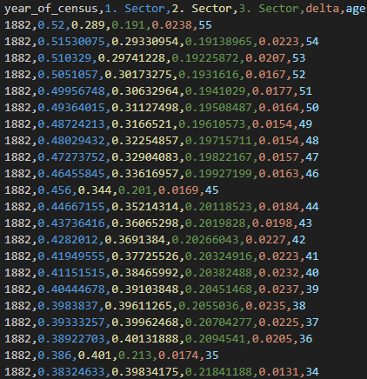
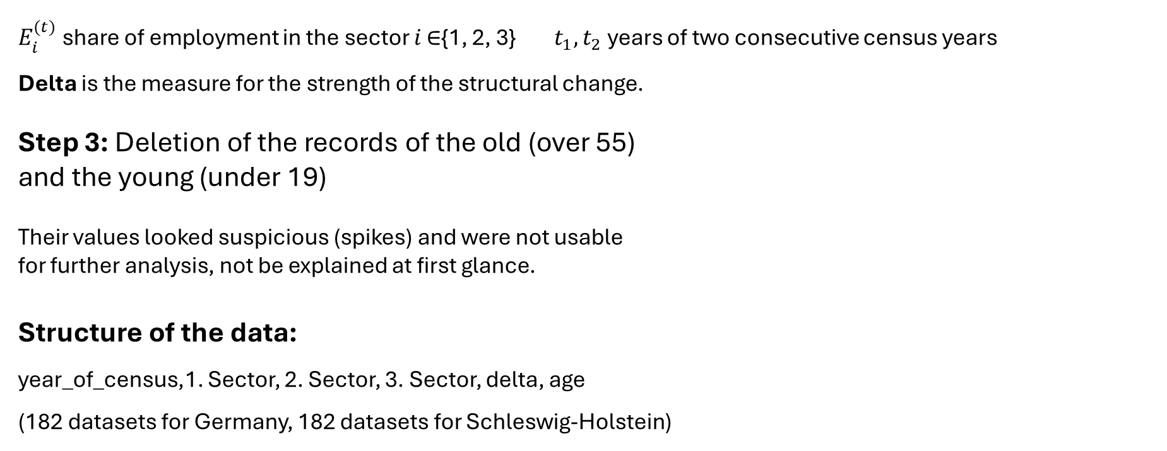
Data Preprocessing
Step 2: Calculation of the yearly average change (delta) between the census years for each birth cohort:
$E_{i}^{(t)}$share of employment in the sector 𝑖 ∈{1, 2, 3} $t_{1},t_{2}$years of two consecutive census years
Delta is the measure for the strength of the structural change.
Step 3: Deletion of the records of the old (over 55) and the young (under 19)
Their values looked suspicious (spikes) and were not usable for further analysis, not be explained at first glance.
Structure of the data: year_of_census,1. Sector, 2. Sector, 3. Sector, delta, age
(182 datasets for Germany, 182 datasets for Schleswig-Holstein)

Slide 11
Literature Review
The paper “CAREER: Transfer Learning for Economic Prediction of Labor Data” – by anonymous authors (conference paper at ICLR 2023, May 2023 in Rwanda) has a similar question.
The aim of the study was to predict career paths and wages. To achieve this, the authors combined large-scale online data with smaller survey datasets. They developed a transformer-based model called CAREER, which was first pretrained on 24 million online résumés and later fine-tuned using previously collected survey data.
CAREER was highly effective at predicting employment sequences.
In my project, I adopted a similar approach – but on a much smaller scale. I tested several ideas:
Fewer layers: CAREER used 12, while my model utilized 3.
Dropout rate of 0.1 (effective).
LayerNormalization after each layer to stabilize the model across all features (no significant effect observed).
GELU (Gaussian Error Linear Unit) activation function, allowing smoother gradients and small negative values (no significant effect observed)

Slide 12
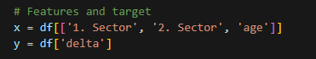
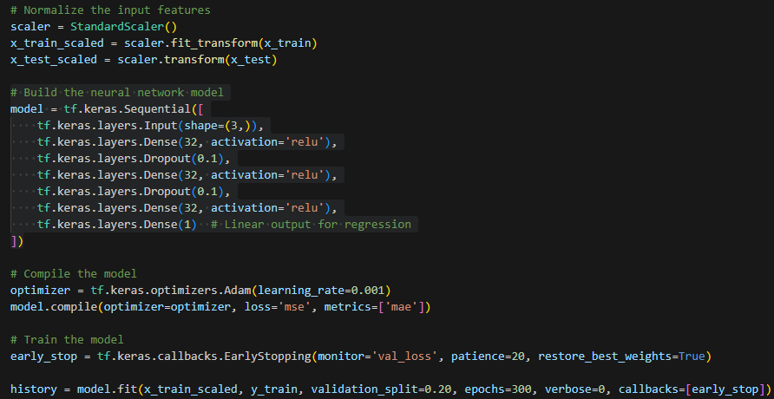
Baseline Model
Simple neural network model
Feature selection: Since the sector shares sum up to 100%, only two of them are needed; third (last) sector is deleted as feature.
Features ‘1. Sector’, ‘2. Sector’ and ‘age’ are normalized
‘delta’ (the strength of the transformation) is the target

Slide 13
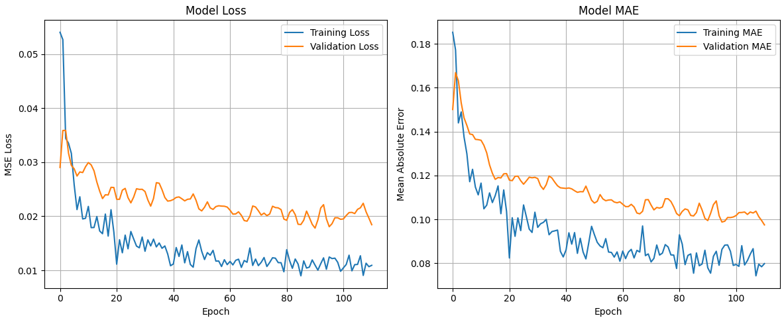
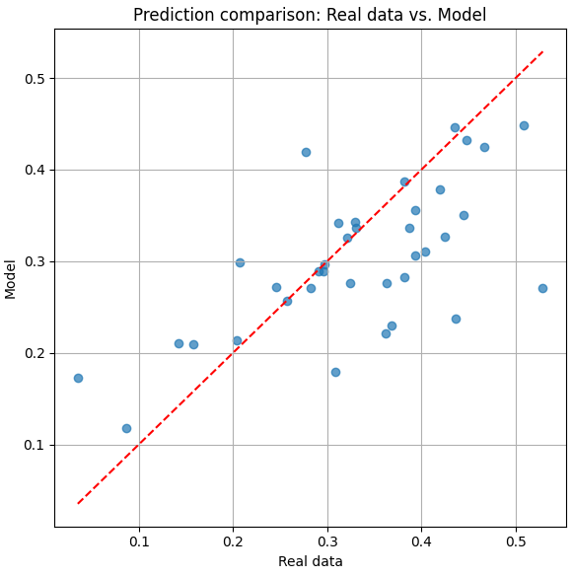
Baseline Model
Baseline Model:
 | Training | Validation
MSE Loss | 0.0109 | 0.0184
MAE | 0.0798 | 0.0975

Slide 14
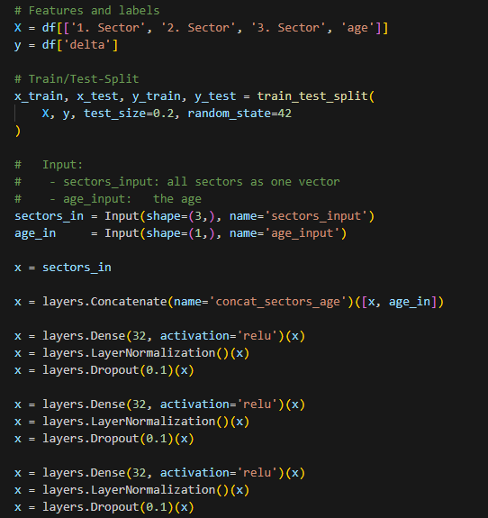
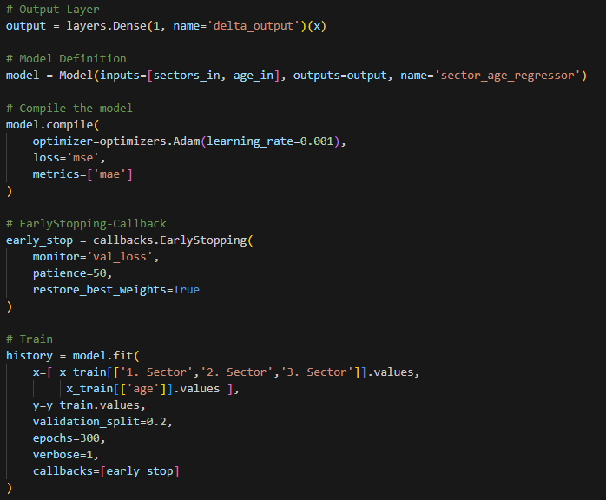
Model Definition and Evaluation
Changes (compared to the baseline model):
Feature selection: the three sector features are combined into a single vector, with ‘age’ kept separate
Various experiments failed to improve the model: Normalization via StandardScaler, LayerNormalization, GELU activation functions, different learning rates and numbers of epochs, and various dropout configurations.

Slide 15
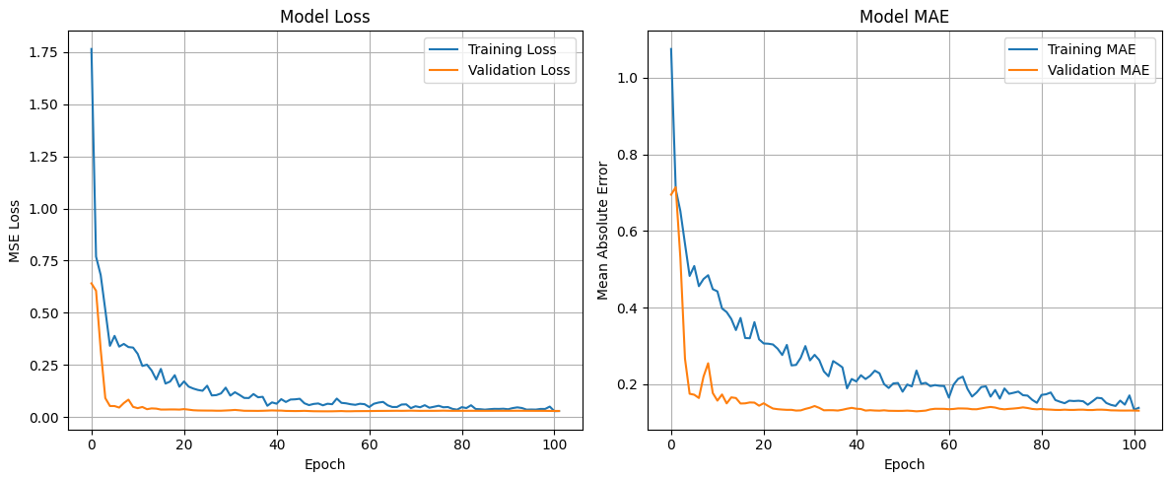
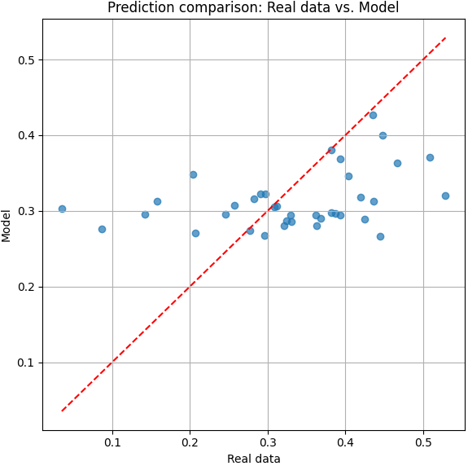
Model Definition and Evaluation
Baseline Model:
Final Model:
 | Training | Validation
MSE Loss | 0.0109 | 0.0184
MAE | 0.0798 | 0.0975
 | Training | Validation
MSE Loss | 0.0286 | 0.0289
MAE | 0.1382 | 0.1309

Slide 16

Results
Baseline Model is a good base!
More work and refinement and time are needed (future work)!
182 datasets are not very much – but they are sufficient for this simplified model.

Slide 17
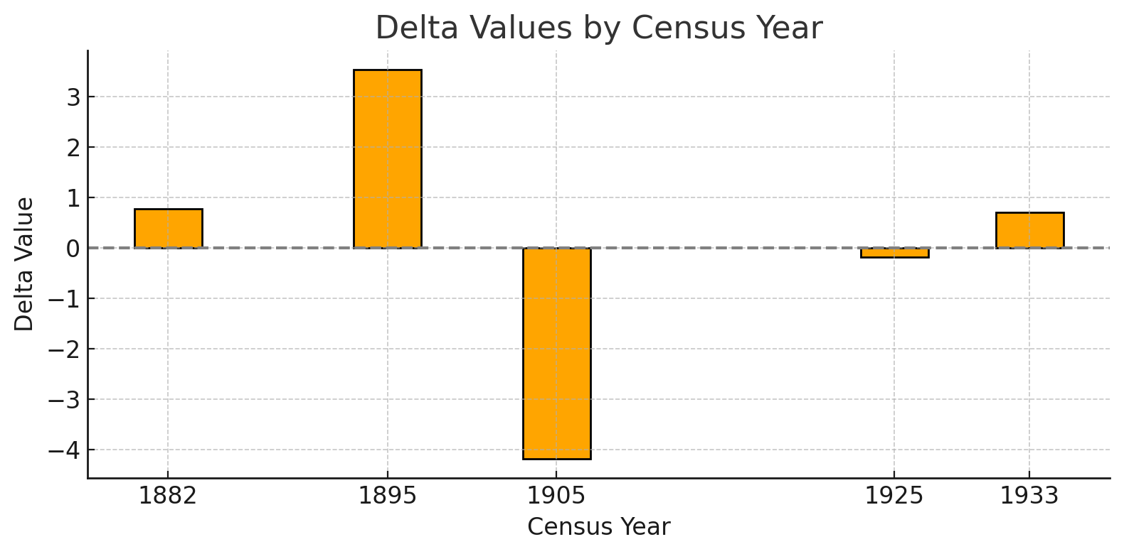
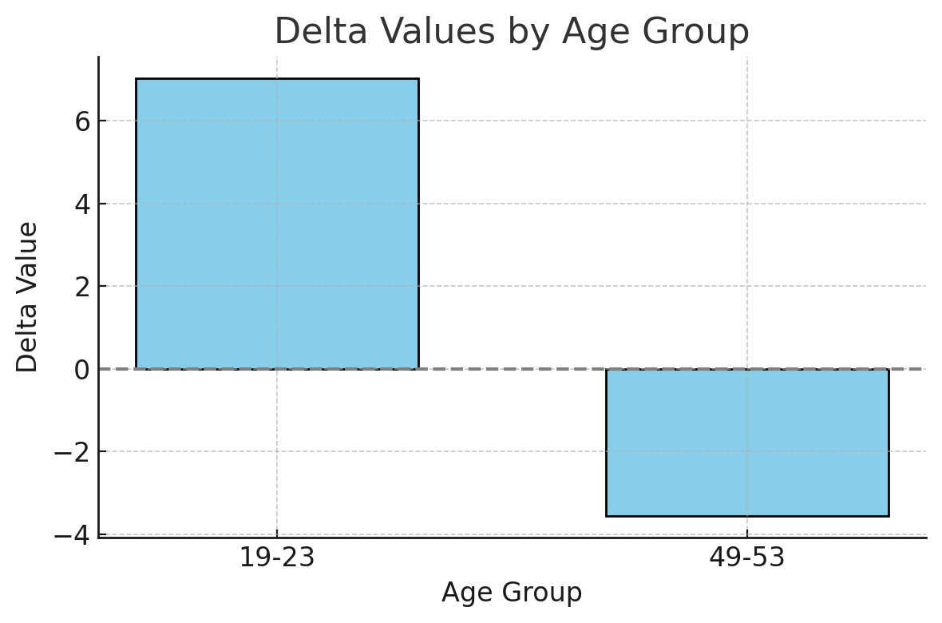
Results
Results for Schleswig-Holstein – strength of sectoral transformation
Difference between the historical and the expected development. The model was trained on data from the German Empire and then applied to the data from Schleswig-Holstein.
stronger transformation
weaker transformation

Slide 18


Challenges and Errors
One might ask whether a neural network was necessary for this purpose — it probably could have been done without it.
Alternatively, significantly more data would likely be required — a bigger boat needed.
A better indicator for the intensity of the transformation would have been helpful.
Additionally, developing a more precise indicator for transformation intensity and conducting analyses at the occupational rather than sectoral level might yield further insights.
Overall, although challenging, the project was highly rewarding.
The many parameters and options that TensorFlow offers were at times overwhelming. And English isn't exactly a strong base for me.

Slide 19

Discussion – Conclusion – Q&A
Any questions?

